Slide 1
OWASP Application Security Verification Standard 3.0
Level 2 - Two Day Training
27 June 2016

Slide 2
Introductions

Slide 3

Andrew van der Stock
Principal Consultant
Doing appsec since 1998
OWASP Board member
OWASP ASVS
OWASP Top 10 2007
OWASP Dev Guide
Family, cats, WRC nut

Slide 4

Jim Manico
OWASP Board Member
Web Developer since 1997
Application Security Educator
OWASP ASVS
OWASP Proactive Controls
Kauai, Hawaii Resident
Laser Pong World Champion

Slide 5
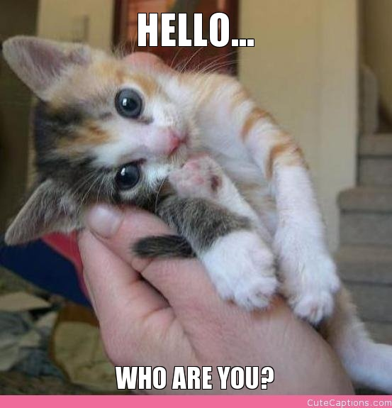
Who are you?
Name
Role
Serial number (joking)
What are your biggest challenges?
What do you want out of the course?

Slide 6
Agenda - Day 1
Day 1
Afternoon
Introductions
About ASVS
Incorporating ASVS into your development lifecycle
Architecture
Authentication
Session Management
Access Control

Slide 7
Agenda - Day 2
Morning
Afternoon
Malicious input handling
Cryptography at rest
Error Handling
Communications Security
HTTP Security
Business Logic Flaws
Files and Resources
Mobile Security
Web Service Security
Configuration
Capture the Flag

Slide 8
OWASP Application Security Verification Standard 3.0
Web Application Technical Security Controls, Unleashed!

Slide 9

OWASP
The Open Web Application Security Project (OWASP) is a 501(c)(3) worldwide not-for-profit charitable organization focused on improving the security of software.
Our mission is to make software security visible, so that individuals and organizations worldwide can make informed decisions about true software security risks.
Everyone is free to participate in OWASP and all of our materials are available under a free and open software license. You'll find everything about OWASP linked from our wiki and current information on our OWASP Blog.
https://owasp.org

Slide 10
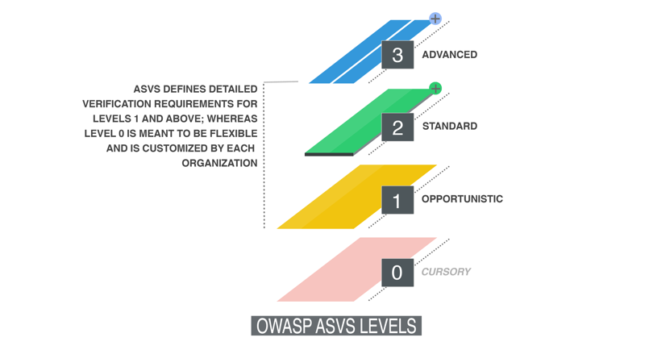
Application Security Verification Standard 3.0
First application security standard by developers, for developers
Defines three risk levels with around 150 controls
Similar but not the same: ISO 27034

Slide 11
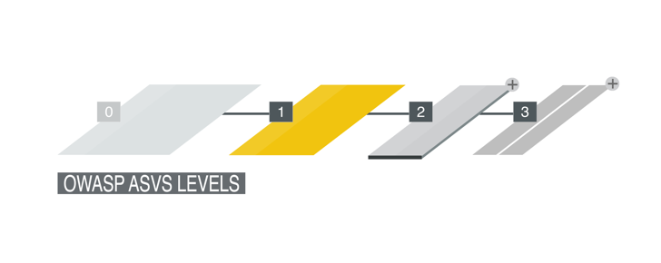
Application Security Verification Standard 3.0
Level 1: Baseline
Minimum required for all apps
Mostly fully testable
Mostly automatable
82 Controls

Slide 12
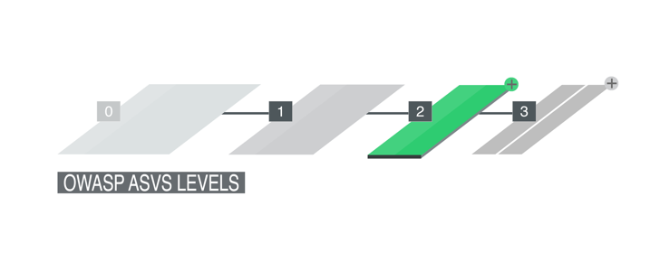
Application Security Verification Standard 3.0
Level 2: Standard
Suitable for sensitive data
About 75% testable
Somewhat automatable
139 Controls

Slide 13
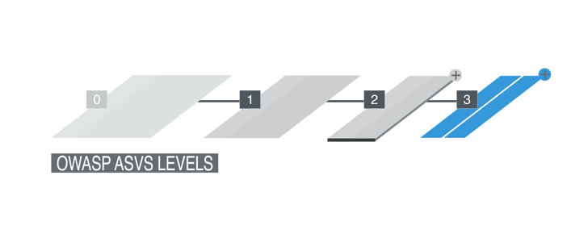
Application Security Verification Standard 3.0
Level 3: Comprehensive
Suitable for critical apps
Mostly testable, but many more manual verifications required
Not amenable to automation
154 Controls

Slide 14

How to fork and use ASVS
Building the Application Security Verification Standard into your SDLC

Slide 15
Let’s talk about your SDLC
Waterfall
Agile
Watergile?
What are some of your challenges?
What are some of your successes?
Segregation of duties?
Change control?
DevOps?
How have you responded to incidents in the past?

Slide 16
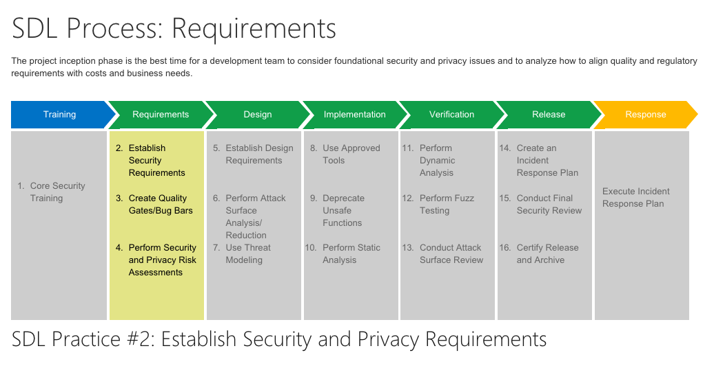
Microsoft SDL for waterfall

Slide 17
Planning in security in agile
You Are Gonna Need It (YAGNI)
Developers are engineers
Building secure software
Design for security
Protect
Detect
Resilient
Planning spike
Retrospectives
User stories
Peer reviews
Use cases with constraints
Integration tests
Abuse cases
TDD - Unit tests

Slide 18
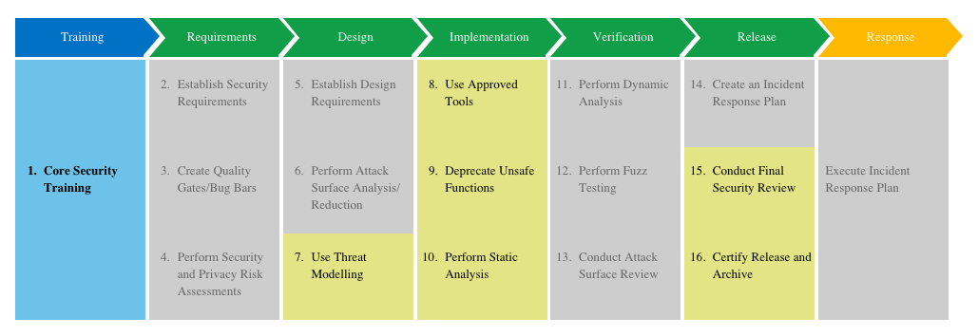
Microsoft SDL for Agile

Slide 19
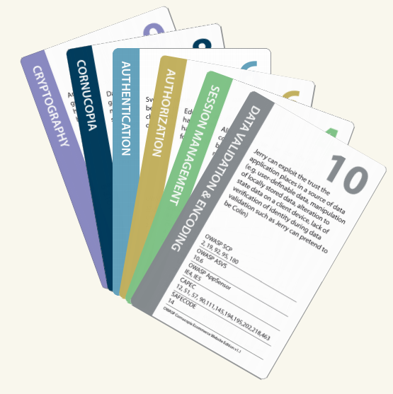
OWASP Cornucopia
Aligned with web app risks
Let’s play the game
Can download for free
Can buy from OWASP Merchandising Store

Slide 20
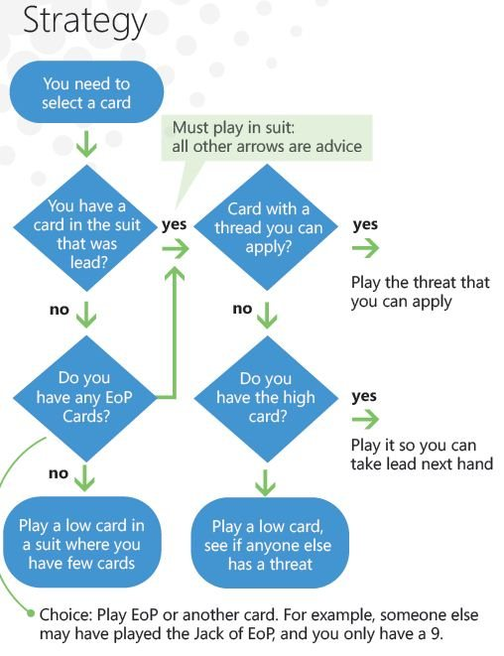
Elevation of privilege
Aligned with Microsoft SDL
Let’s play the game
Can buy from Microsoft
Can download and print

Slide 21
Writing unit tests using the ASVS
Write unit tests to validate your application each and every build
Allows penetration testers to concentrate on difficult to automate tests, such as business logic flaws, access control issues, and things you forgot in the unit tests

Slide 22
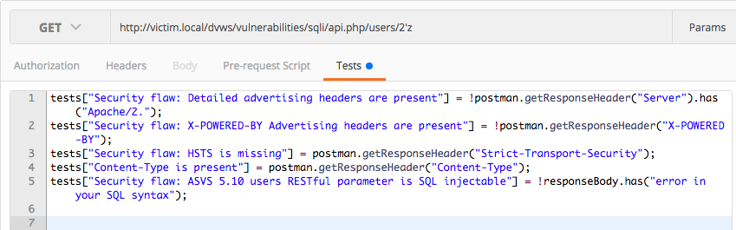
Writing integration tests
Integration tests can be written using Postman, Selenium, OWASP Zap API

Slide 23
Running your private lab
OWASP Security Shepherd in Vagrant

Slide 24
WebGoat 7
Developer Mode

Slide 25
Security Shepherd
CTF and points for Gryffindor

Slide 26
Testing access to my CTF

Slide 27
Architecture
Design security in

Slide 28
Mission Essential Task List
Do essential things first. There is not enough time for the commander to do everything. Each commander will have to determine wisely what is essential, and assign responsibilities for accomplishment. He should spend the remaining time on near essentials. This is especially true of training. Nonessentials should not take up time required for essentials.
General Bruce C. Clarke
Duration | 60 minutes
Learning Objectives | To understand all you can about the application to be assessed.
Major Tasks | Identity all necessary components,
Conditions | Access to functional specification documentation
Performance Standard | At the end to be able to successfully use a threat model tool to map out all known threats the system might face.
Tools Required | Threat modeling tool/Attack surface reduction tool.
Notes:
The idea behind the METL is that it lays out exactly what you will be doing, how long for, the tasks you should expect to do and under what conditions and to what standard. Finally it helps you understand the tools required to achieve said tasks.
An idea: We show them architecture and authentication and then moving forward in the class, we get them to build up the METL. Grab a student and ask them to flesh it out? Gets them thinking and helps with interaction

Slide 29
ASVS 1.1 Identify all necessary components
Verify that all application components are identified and are known to be needed.
All software has defects
Ensure all components and libraries you link with are necessary and you know what they do
Understand the data assets they publish.

Slide 30
ASVS 1.2 Identify all necessary components
Verify that all components, such as libraries, modules, and external systems, that are not part of the application but that the application relies on to operate are identified.
Ensure all components and libraries you link with are necessary and you know what they do

Slide 31
ASVS 1.3 Identify all necessary components
Verify that a high-level architecture for the application has been defined.
Helps identify if the team maintains basic documentation
Often discouraged in the agile world

Slide 32
ASVS 1.8 Identify all necessary components
Verify that components are segregated from each other via a defined security control, such as network segmentation, firewall rules, or cloud based security groups.
Use security groups in AWS
Consider the corporate network as completely BYOD, and ensure that the application is self defending

Slide 33
ASVS 1.9 Identify all necessary components
Verify the application has a clear separation between the data layer, controller layer and the display layer, such that security decisions can be enforced on trusted systems.
MVC
MVVM
MVP
Some of these architectural patterns are insecure by design.
Single page apps, scripts with no structure

Slide 34
ASVS 1.10 Identify all necessary components
Verify that there is no sensitive business logic, secret keys or other proprietary information in client side code.
Affects single page apps, PHP and classic ASP more than most
Also, mobile apps

Slide 35
Demo:
Threat Modelling Tool

Slide 36
Demo:
Attack surface reduction tool

Slide 37
Authentication

Slide 38
Mission Essential Task List
Duration | 60 minutes
Learning Objectives | To understand how to implement authentication as per the risk
Major Tasks | Identify evidence of identity, trusted parties, relying parties, and processes and identity stores
Conditions | Understanding the risk posed by the assets being protected
Performance Standard | Ensuring that the system has strong identity and access management, can detect and respond to modern password re-use, abuse, and remain resilient in the face of advanced attackers
Tools Required | Security Shepherd, OWASP Zap
Notes:
The idea behind the METL is that it lays out exactly what you will be doing, how long for, the tasks you should expect to do and under what conditions and to what standard. Finally it helps you understand the tools required to achieve said tasks.

Slide 39
2.1 Principle of complete mediation
Verify all pages and resources by default require authentication except those specifically intended to be public (Principle of complete mediation).
Ensure your authentication mechanism enforces login on ALL non-public resources
Public resources:
Public website
Registration
Login
Forgot password

Slide 40
2.2 Do not pre-fill passwords
Verify that all password fields do not echo the user’s password when it is entered.
Pre-filling password fields implies access to the stored plaintext password
A specialty of SOHOpeless ADSL routers

Slide 41
2.4 Trusted enforcement
Verify all authentication controls are enforced on the server side.
Client side authentication is trivial to bypass
Enforce after making a decision on the server
Provide a new session id or RESTful token post authentication

Slide 42
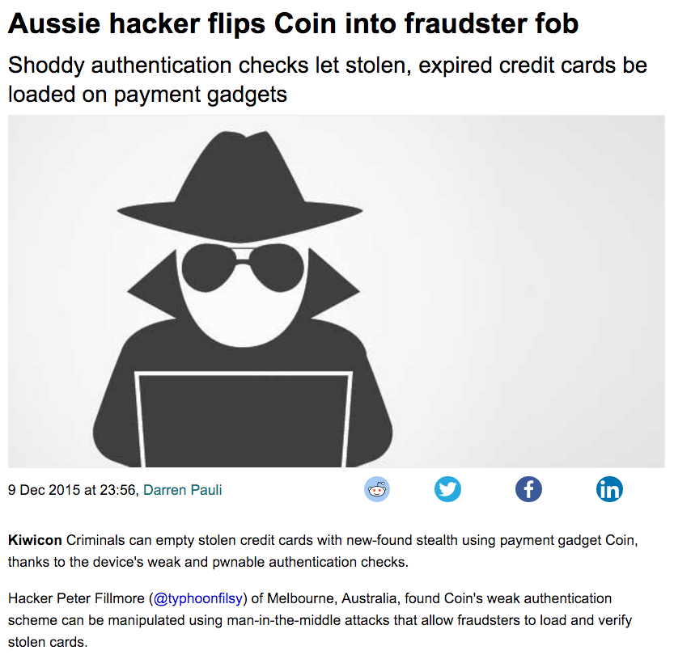
2.4 Trusted enforcement
Verify all authentication controls are enforced on the server side.
Notes:
Happens quite a bit, I’m afraid

Slide 43
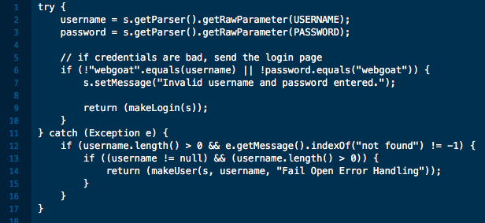
2.6 Fail closed
Verify all authentication controls fail securely to ensure attackers cannot log in.

Slide 44
2.7 Passphrases
Verify password entry fields allow, or encourage, the use of passphrases, and do not prevent long passphrases/highly complex passwords being entered.
Passwords are broken for all purposes
Encourage users to use long passphrases or password managers
Eliminate upper limits on password length
Prevent passwords < 12 chars

Slide 45
2.8 Secure Account Recovery
Verify all account identity authentication functions (such as update profile, forgot password, disabled / lost token, help desk or IVR) that might regain access to the account are at least as resistant to attack as the primary authentication mechanism.
Account recovery is often much weaker than account registration
Passwords re-use
We have good social engineering scripts to attack CSRs
Account enumeration
Email enumeration
Shared knowledge questions are trivial to bypass
Notes:
Open Have I been pwned

Slide 46
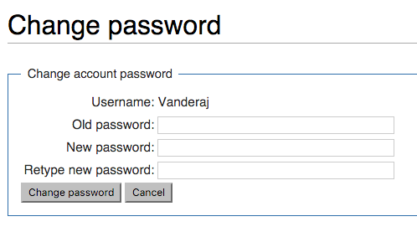
2.9 Password Change 101
Verify that the changing password functionality includes the old password, the new password, and a password confirmation.

Slide 47
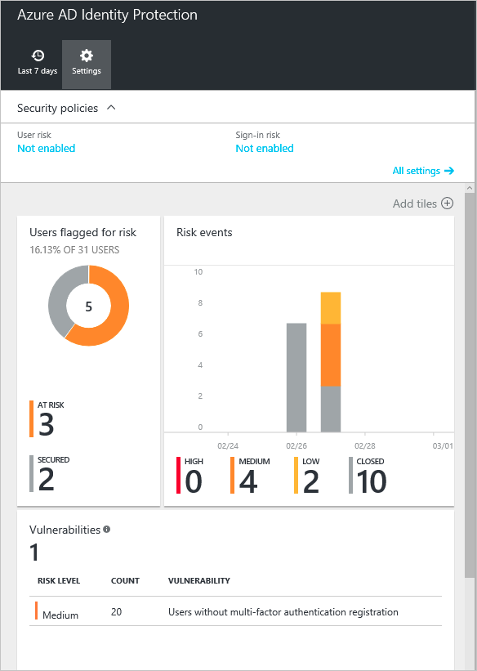
2.12 Log suspicious authentication attempts
Verify that all suspicious authentication decisions are logged. This should include requests with relevant metadata needed for security investigations.

Slide 48
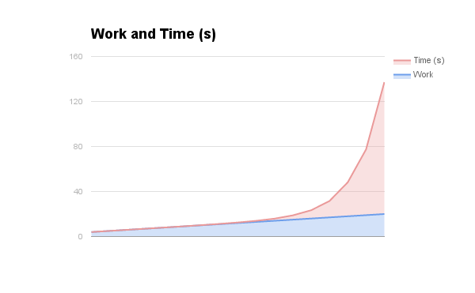
2.13 Use PBKDF or bcrypt with work factor
Verify that account passwords make use of a sufficient strength hashing routine with salting, and that it withstands brute force attack against the encryption routine.

Slide 49
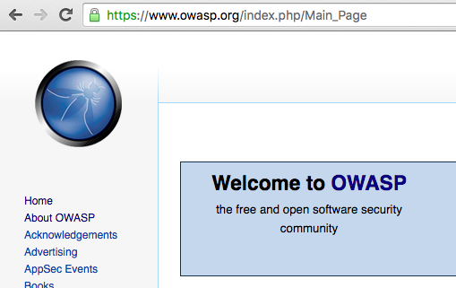
2.16 Always use TLS. Always.
Verify that credentials are transported using a suitable encrypted link and that all pages/functions that require a user to enter credentials are done so using an encrypted link.

Slide 50
2.17 Send time limited password reset nonces
Verify that the forgotten password function and other recovery paths do not reveal the current password and that the new password is not sent in clear text to the user.
Do
Send a random code via e-mail or preferably SMS or push notifications
Do not lock accounts until they are fully reset
Advise users via e-mail or SMS that their password was reset
Do not keep “encrypted” passwords
Do not train users to click links

Slide 51
2.18 Use same information and error messages
Verify that information enumeration is not possible via login, password reset, or forgot account functionality.
Errors should be the same between valid and invalid accounts
Time taken for a failure should be randomized to throw off time based attacks

Slide 52
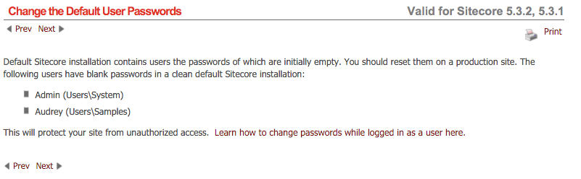
2.19 Remove or change all default passwords
Verify there are no default passwords in use for the application framework or any components used by the application (such as “admin/password”).

Slide 53
2.20 Make sure users are human
Verify that request throttling is in place to prevent automated attacks against common authentication attacks such as brute force attacks or denial of service attacks.
Max number of attempts per IP per day
Better business process
CAPTCHA if you must

Slide 54
2.21 Encrypt external credentials
Verify that all authentication credentials for accessing services external to the application are encrypted and stored in a protected location.
This is oAuth secrets, API keys, sftp creds, etc stored on servers

Slide 55
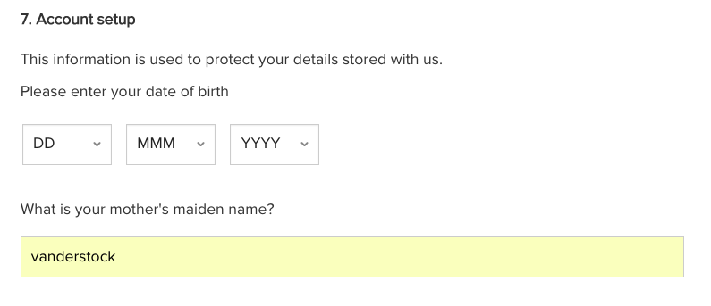
2.22 Advanced Secure Account Recovery
Verify that forgotten password and other recovery paths use a soft token, mobile push, or an offline recovery mechanism.

Slide 56
2.23 Soft lock only
Verify that account lockout is divided into soft and hard lock status, and these are not mutually exclusive. If an account is temporarily soft locked out due to a brute force attack, this should not reset the hard lock status.
Denial of service if you use hard lock
Soft lock is to make brute forcing infeasible against a single account
Locks do nothing if the attackers have the actual username + pw

Slide 57
2.24 Shared knowledge questions
Verify that if shared knowledge based questions (also known as "secret questions") are required, the questions should be strong enough to protect the application.
Many questions can be easily answered by Facebook stalkers
Your birthday is not a secret
Your mother’s maiden name is regulated under Australian Privacy Principles and is illegal to collect and use without her consent
https://www.owasp.org/index.php/Choosing_and_Using_Security_Questions_Cheat_Sheet

Slide 58
2.25 Keep a password history
Verify that the system can be configured to disallow the use of a configurable number of previous passwords.
Useful for corporate systems that have to comply with ISO 27002
Not useful for normal systems

Slide 59
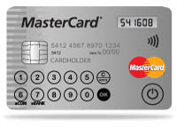
2.25 Re-authentication for high privilege
Verify re-authentication, step up or adaptive authentication, two factor authentication, or transaction signing is required before any application-specific sensitive operations are permitted as per the risk profile of the application.
This is transaction signing, which is a step beyond 2FA

Slide 60
2.27 Users will always choose weak passwords
Verify that measures are in place to block the use of commonly chosen passwords and weak passphrases.
Password reuse is a major issue
Use a common password list like SecLists to deny the use of any password or those found using John the Ripper rules processing in such a password list

Slide 61
2.28 Add in random time padding
Verify that all authentication challenges, whether successful or failed, should respond in the same average response time.
This is to prevent advanced attackers working side channel information, such as account enumeration or crypto algorithms in use.

Slide 62
2.29 No secrets in source code repos
Verify that secrets, API keys, and passwords are not included in the source code, or online source code repositories.
GitHub gives warnings now, but is still a rich source of “secrets” within code
Use a script to check in your code if you have secrets in web.xml or similar

Slide 63
2.30 Trusted authentication mechanism
Verify that if an application allows users to authenticate, they use a proven secure authentication mechanism.
Invest in one good authentication mechanism:
Federation
Two factor authentication
Resilient
Secure
Do not have many different authentication mechanisms

Slide 64
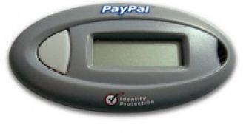
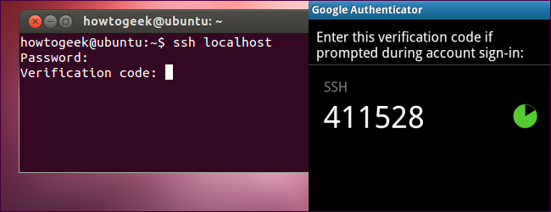
2.31 Multi-factor authentication FTW
Verify that if an application allows users to authenticate, they can authenticate using two-factor authentication or other strong authentication, or any similar scheme that provides protection against username + password disclosure.

Slide 65
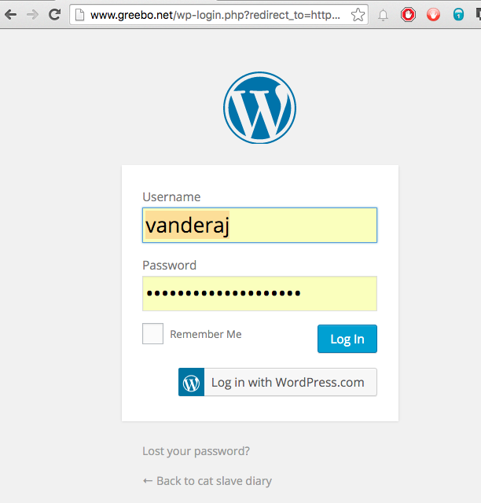
2.32 Administrative interfaces
Verify that administrative interfaces are not accessible to untrusted parties

Slide 66
Authentication Demo
Security Shepherd
Getting to know the app and the code
Creating a user
Do some attacks

Slide 67
Session management

Slide 68
Mission Essential Task List
Duration | 30 minutes
Learning Objectives | To learn about configuring and using session managers well
Major Tasks | Learn the fundamentals of what makes a good session manager, where to store security metadata
Conditions | Must be authenticated
Performance Standard | Identify secure session manager use, and strong session token configuration
Tools Required | OWASP Zap, Eclipse or a text editor
Notes:
The idea behind the METL is that it lays out exactly what you will be doing, how long for, the tasks you should expect to do and under what conditions and to what standard. Finally it helps you understand the tools required to achieve said tasks.

Slide 69
3.1 Don’t write your own session manager
Verify that there is no custom session manager, or that the custom session manager is resistant against all common session management attacks.
Wasn’t a problem for many years
RESTful web services have seen a resurgence in very weak session identifiers

Slide 70
3.2 Clear sessions upon logout
Verify that sessions are invalidated when the user logs out.
Session.Abandon() is your friend
Simple to test:
Press “Back” after logging out
If you can see any information, try again
If you are logged back in, try again

Slide 71
3.3 Session timeouts
Verify that sessions timeout after a specified period of inactivity.
Various values are acceptable, based upon risk
Banking apps 5 minutes or less
Most apps 20 minutes (default)
Longer by exception

Slide 72
3.4 Administrative idle out
Verify that sessions timeout after an administratively-configurable maximum time period regardless of activity (an absolute timeout).
Absolute timeouts are useful for requiring re-authentication if you’re using bearer refresh tokens
Decide on 14, 28, 90 days

Slide 73
3.5 Logout on every page
Verify that all pages that require authentication have easy and visible access to logout functionality.
Many app owners want folks to stay logged in. Don’t be these app owners

Slide 74
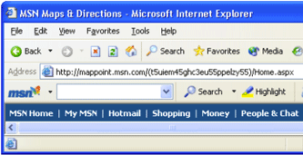
3.6 Protect session IDs from disclosure
Verify that the session id is never disclosed in URLs, error messages, or logs. This includes verifying that the application does not support URL rewriting of session cookies.
Not a default setting
Do not set <sessionState cookieless="true" /> in web.config
Do not use ApplyAppPathModifier()

Slide 75
3.7 Regenerate session IDs
Verify that all successful authentication and re-authentication generates a new session and session id.
Actually, quite difficult to do in ASP.NET
ASP.NET Membership provider sets a new cookie – ASPXAUTH to get around this problem.

Slide 76
3.10 Framework only session IDs
Verify that only session ids generated by the application framework are recognized as active by the application.
Some application frameworks will accept any old session ID.
cough * PHP *
Don’t be PHP

Slide 77
3.11 Random enough
Verify that session ids are sufficiently long, random and unique across the correct active session base.
In RESTful web services, if you create a weak session token, it will be easy to create a valid token for another user.
This is found in PeopleSoft PS_TOKEN and many other implementations

Slide 78
3.12 Protect session identifiers
Verify that session ids stored in cookies have their path set to an appropriately restrictive value for the application, and authentication session tokens additionally set the “HttpOnly” and “secure” attributes
With many sites using front end load balancers, it’s pretty common to set no PATH or DOMAIN attributes
HttpOnly prevents JavaScript from accessing a cookie
Secure prevents the cookie transiting over insecure links

Slide 79
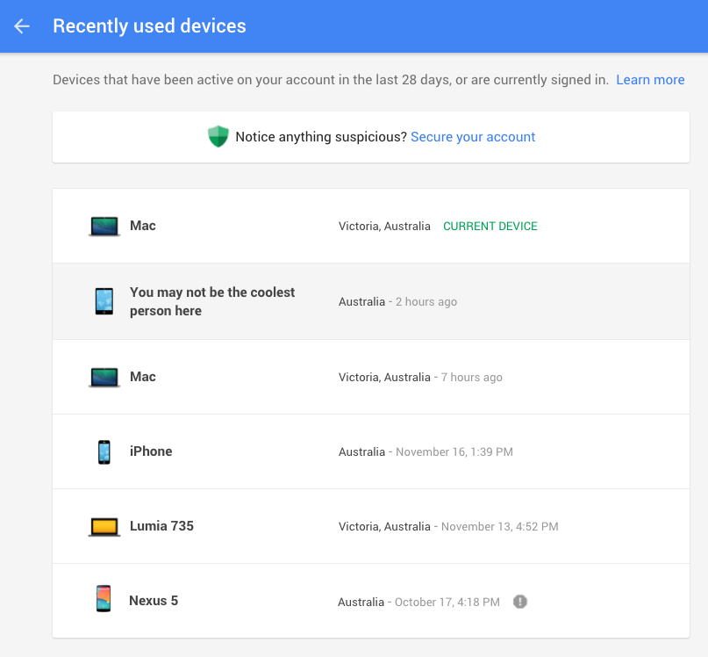
3.16 Advanced session management
Verify that the application limits the number of active concurrent sessions.

Slide 80
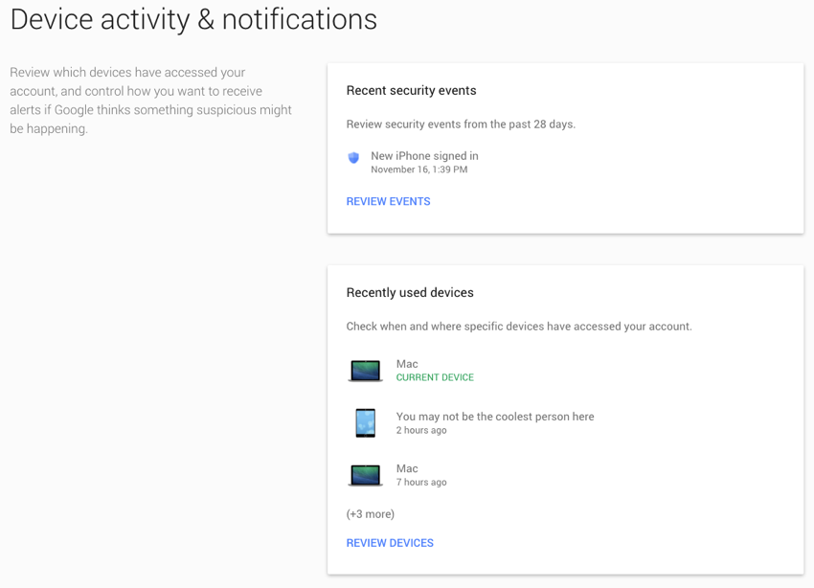
3.17 Advanced session management
Verify that an active session list is displayed in the account profile or similar of each user. The user should be able to terminate any active session.

Slide 81
3.18 Advanced session management
Verify the user is prompted with the option to terminate all other active sessions after a successful change password process.
Post account breach, it’s important to be able to deny access to long lived tokens on attacker devices.
Allow the user to control which devices stay logged in, or simply log them all out.

Slide 82
Session management lab
Security Shepherd

Slide 83
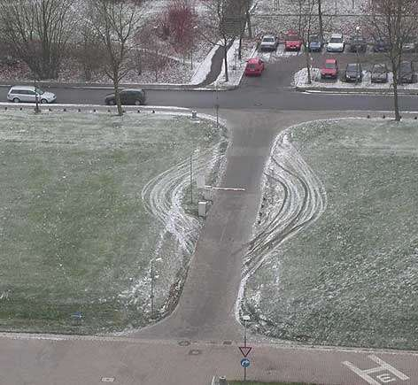
Access control
Acting as admin since 1998

Slide 84
Mission Essential Task List
Duration | 60 minutes
Learning Objectives | Learn about the many different ways access controls need to be implemented and bypassed
Major Tasks | Access control principals, presentation layer access control, model / view access controls, controller access control, direct object references, and aggregate and anti-automation
Conditions | None
Performance Standard | Should be able to identify code that has missing access control checks, how to implement these using the principal of least privilege, and ensuring usable anti-automation techniques
Tools Required | OWASP Zap, a code editor
Notes:
The idea behind the METL is that it lays out exactly what you will be doing, how long for, the tasks you should expect to do and under what conditions and to what standard. Finally it helps you understand the tools required to achieve said tasks.

Slide 85
4.1 Principle of least privilege
Verify that the principle of least privilege exists - users should only be able to access functions, data files, URLs, controllers, services, and other resources, for which they possess specific authorization. This implies protection against spoofing and elevation of privilege.
Permissions granted
Permissions needed

Slide 86
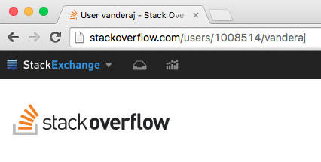
4.4 Data protection
Verify that access to sensitive records is protected, such that only authorized objects or data is accessible to each user (for example, protect against users tampering with a parameter to see or alter another user's account).

Slide 87
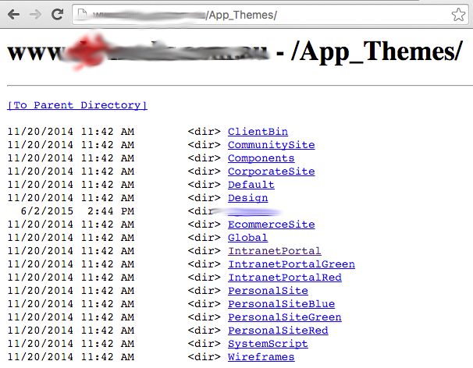
4.5 Directory listings
Verify that directory browsing is disabled unless deliberately desired. Additionally, applications should not allow discovery or disclosure of file or directory metadata, such as Thumbs.db, .DS_Store, .git or .svn folders.

Slide 88
4.8 Fail closed
Verify that access controls fail securely.
Write access control checks in the positive, not the negative:
Roles: banned, guest, user, moderator, admin, superadmin
if ( !(user.inRole(guest|user|mod)) ) {
// perform some admin task
}

Slide 89
4.9 Server side enforcement
Verify that the same access control rules implied by the presentation layer are enforced on the server side.
Client side authorization, such as checks to enable a button or show a privileged panel must be backed up with server side enforcement

Slide 90
4.10 Protect access control metadata
Verify that all user and data attributes and policy information used by access controls cannot be manipulated by end users unless specifically authorized.
No admin=1 or role=admin in the URL or cookie
If using JWT, make sure the entitlement is not just hashed, but digitally signed
https://jwt.io/#debugger-io

Slide 91
4.11 Centralized access enforcement
Verify that there is a centralized mechanism (including libraries that call external authorization services) for protecting access to each type of protected resource.

Slide 92
4.12 Log all access control failures
Verify that all access control decisions can be logged and all failed decisions are logged.

Slide 93
4.13 Prevent cross-site request forgery
Verify that the application or framework uses strong random anti-CSRF tokens or has another transaction protection mechanism.
A simple CSRF request forgery is to change an avatar to point to
https://example.com/logout.mvc
This automatically logs out anyone who tries to view the hostile avatar.

Slide 94
4.14 Aggregate access control limits
Verify the system can protect against aggregate or continuous access of secured functions, resources, or data. For example, consider the use of a resource governor to limit the number of edits per hour or to prevent the entire database from being scraped by an individual user.
The number one issue today is the testing of systems from many different IP addresses with stolen / re-used credentials
CAPTCHA has its own problems
Consider risk based authentication, including per IP limits, and so on

Slide 95
4.15 Step up access controls
Verify the application has additional authorization (such as step up or adaptive authentication) for lower value systems, and / or segregation of duties for high value applications to enforce anti-fraud controls as per the risk of application and past fraud.
Use where most conditions are acceptable to have public / open access, but you want to step up to a more secure authorization
e.g. quick balances without being logged in, but transfer funds = step up

Slide 96
4.16 Enforce role based permissions
Verify that the application correctly enforces context-sensitive authorization so as to not allow unauthorized manipulation by means of parameter tampering.
This is a very fancy way of saying
Don’t use role=user
Don’t use admin=true
Don’t use debug=1
In headers, cookies, URL arguments, or in HTTP requests

Slide 97
Authorization Demos
WebGoat
Security Shepherd

Slide 98

Malicious input handling
Inject all the things

Slide 99
Mission Essential Task List
Duration | 60 minutes
Learning Objectives | To understand all you can about the application to be assessed.
Major Tasks | Identify the many different ways an application can be injected, the root cause (mixing data and executable content), and how best to avoid this entire bug class
Conditions | Poorly engineered code that doesn’t take into account where hostile data can be injected into running code
Performance Standard | Be able to identify code that has injection issues, write unit or integration tests that can test for these, and understand the methods for exploiting these injection issues
Tools Required | OWASP Zap, Code editor or similar
Notes:
The idea behind the METL is that it lays out exactly what you will be doing, how long for, the tasks you should expect to do and under what conditions and to what standard. Finally it helps you understand the tools required to achieve said tasks.

Slide 100
5.1 Buffer overflows
Verify that the runtime environment is not susceptible to buffer overflows, or that security controls prevent buffer overflows.
Gonna skip this one; primarily affects system languages (C, C++, Objective C)
Does not affect (mostly) C#, CLR, JVM, Go, and a bunch of other languages
But they call code written in C, C++ or assembler…

Slide 101
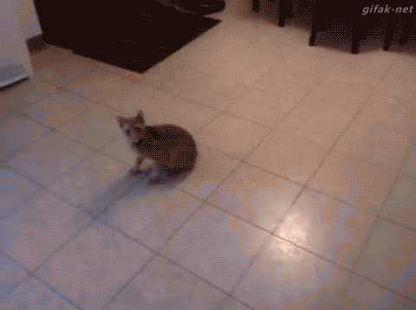
5.3 Log input validation failures
Verify that server side input validation failures result in request rejection and are logged.
Your code is the first and sometimes the only line of defence

Slide 102
5.5 Enforce input validation on trusted devices
Verify that input validation routines are enforced on the server side.
If you build a mobile or responsive app with client side business logic, input validation, or access control enforcement, expect it to be bypassed.
Always enforce on a trusted server!

Slide 103
5.6 Centralized input validation routines
Verify that a single input validation control is used by the application for each type of data that is accepted.

Slide 104

5.10 Protect data sources from SQL injection
Verify that all SQL queries, HQL, OSQL, NOSQL and stored procedures, calling of stored procedures are protected by the use of prepared statements or query parameterization, and thus not susceptible to SQL injection

Slide 105
5.11 Protect against LDAP injection
Verify that the application is not susceptible to LDAP Injection, or that security controls prevent LDAP Injection.
Not commonly seen… except for unauthenticated login forms and user search fields
LDAP injection is bad if you can match another well known default user in another OU or you match the first result regardless

Slide 106
5.12 Protect against command injection
Verify that the application is not susceptible to OS Command Injection, or that security controls prevent OS Command Injection.
Due to mixture of hostile user data sent to shell, script, or batch systems, additional commands can be run
Effectively CVSS 10.0. Or 9.0 if you have to log in first.

Slide 107
5.13 Protect against local and remote file injection
Verify that the application is not susceptible to Remote File Inclusion (RFI) or Local File Inclusion (LFI) when content is used that is a path to a file.
Local file inclusion is where an attacker supplies a different path and or filename, and this is included or eval()’d instead.
Remote file inclusion includes resources from other servers, which are retrieved by the server and executed.

Slide 108
5.14 Protect against XML injection
Verify that the application is not susceptible to common XML attacks, such as XPath query tampering, XML External Entity attacks, and XML injection attacks.
XML injection can add nodes, or potentially alter data depending on how you process XML documents
XPath injection can change the node(s) being selected
XML External Entity Attacks are exactly that – they force the server side XML processor to retrieve instructions from a remote site

Slide 109
5.15 Protect against cross-site scripting
Ensure that all string variables placed into HTML or other web client code is either properly contextually encoded manually, or utilize templates that automatically encode contextually to ensure the application is not susceptible to reflected, stored and DOM Cross-Site Scripting (XSS) attacks.
OWASP Top 10 #A1 or #A2 since 2004.
Reflected XSS creates a temporary confused deputy
Stored XSS makes that a permanent situation
DOM XSS is common in single page applications and responsive applications.

Slide 110
5.16 Safer mass parameter assignment
If the application framework allows automatic mass parameter assignment (also called automatic variable binding) from the inbound request to a model, verify that security sensitive fields such as “accountBalance”, “role” or “password” are protected from malicious automatic binding.
Many modern frameworks allow variables and arrays within user supplied input to be automatically bound by automated parameter assignment.
User[][‘username’] = ‘attacker’;
User[][‘role’] = ‘admin’;

Slide 111
5.17 Parameter pollution attacks
Verify that the application has defenses against HTTP parameter pollution attacks, particularly if the application framework makes no distinction about the source of request parameters (GET, POST, cookies, headers, environment, etc.)
Plays around with where a variable can be found. If it’s found twice, which one is validated, and which one is used? EGPCS is a common order.
If unclear, parameter pollution attacks are possible.

Slide 112
5.18 Client side validation is second line of defense
Verify that client side validation is used as a second line of defense, in addition to server side validation.
Similar to the enforcement strategies outlined in access controls – you must enforce validation on the server, even if it is performed on the client.

Slide 113
5.19 Use positive validation by preference
Verify that all input data is validated, not only HTML form fields but all sources of input such as REST calls, query parameters, HTTP headers, cookies, batch files, RSS feeds, etc; using positive validation (whitelisting), then lesser forms of validation such as grey listing (eliminating known bad strings), or rejecting bad inputs (blacklisting).
Data whitelisting is the easiest and fastest form of validation
Blacklisting is like anti-virus, and assumes you’ve seen all the ways you can break something
Sanitization is eliminating “dangerous” sequences, and again assumes you know more about HTML 5 than the attacker

Slide 114
5.20 Strongly type data
Verify that structured data is strongly typed and validated against a defined schema including allowed characters, length and pattern (e.g. credit card numbers or telephone, or validating that two related fields are reasonable, such as validating suburbs and zip or post codes match).
It is impossible to perform SQL injection on a Boolean variable… most of the time.
Always convert, range check, sign check, and validate user supplied data into the most stringent data type as quickly possible to avoid injection issues.

Slide 115
5.21 Unstructured and international entry
Verify that unstructured data is sanitized to enforce generic safety measures such as allowed characters and length, and characters potentially harmful in given context should be escaped (e.g. natural names with Unicode or apostrophes, such as ねこ or O'Hara)
Always test how your application fares using Unicode characters
There are four ”i” characters in Unicode:
i ì ï í
Some interpreters assume this is “i”, such as in “script”

Slide 116
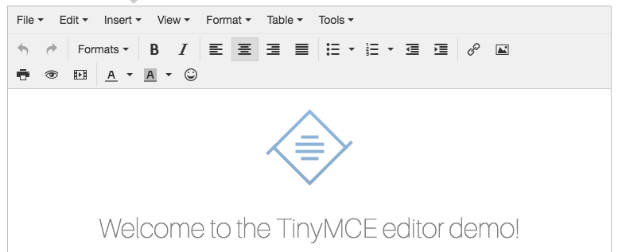
5.22 HTML 5 contextual output encoding
Make sure untrusted HTML from WYSIWYG editors or similar are properly sanitized with an HTML sanitizer and handle it appropriately according to the input validation task and encoding task.
This is for when you allow TinyMCE or other HTML editors to submit text marked up in HTML. Use HTML Purify or similar

Slide 117
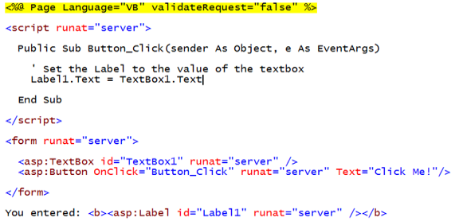
5.23 Auto-escaping HTML templates
For auto-escaping template technology, if UI escaping is disabled, ensure that HTML sanitization is enabled instead.
By default, AngularJS, or DefaultHtmlEscape = true in Spring, or validateRequest in .NET protects against naïve XSS. Whenever you defeat this global setting, you need to make sure that you properly validate and output encode

Slide 118
5.24 Use safer DOM insertion
Verify that data transferred from one DOM context to another, uses safe JavaScript methods, such as using .innerText and .val.
In jQuery, use sandbox accessor methods, DOM insert / append / replace methods, and DOM selector methods as these have protections against DOM XSS
AngularJS – Strict contextual escaping
$sce and $sanitize
https://www.owasp.org/index.php/DOM_based_XSS_Prevention_Cheat_Sheet

Slide 119
5.25 Parsing JSON
Verify when parsing JSON in browsers, that JSON.parse is used to parse JSON on the client. Do not use eval() to parse JSON on the client.
Never just use eval or $scope.eval() on JSON data, this leads to JSON injection
jQuery -
Angul

Slide 120
5.26 Clear client side storage
Verify that authenticated data is cleared from client storage, such as the browser DOM, after the session is terminated.
Local storage includes the DOM, cookies, localStorage.
https://www.owasp.org/index.php/HTML5_Security_Cheat_Sheet

Slide 121
Input validation labs
Security Shepherd

Slide 122
Cryptography at rest

Slide 123
Mission Essential Task List
Duration | 60 minutes
Learning Objectives | Learn about storing data at rest
Major Tasks | Generation of random values, protecting data under privacy laws, and the basics of good cryptography
Conditions | None
Performance Standard | Understanding of how to identify code that might contain missing or ineffective cryptography, and how to design applications that adhere to privacy data protection requirements
Tools Required | OWASP Zap, code editor, WebGoat
Notes:
The idea behind the METL is that it lays out exactly what you will be doing, how long for, the tasks you should expect to do and under what conditions and to what standard. Finally it helps you understand the tools required to achieve said tasks.

Slide 124
7.2 Fail closed
Verify that all cryptographic modules fail securely, and errors are handled in a way that does not enable oracle padding.
Cryptographic failures should not result in no cryptographic storage
Oracle padding attacks are complex beasts. For more information, please see
http://robertheaton.com/2013/07/29/padding-oracle-attack/

Slide 125
7.6 Don’t copy and paste GUIDs from Stack Overflow
Verify that all random numbers, random file names, random GUIDs, and random strings are generated using the cryptographic module’s approved random number generator when these random values are intended to be not guessable by an attacker.
GUIDs are easy to create.
java.util.UUID.randomUUID() System.Guid.NewGuid()
Never copy and paste them, especially for new CLSIDs

Slide 126
7.7 Use approved algorithms, be agile
Verify that cryptographic algorithms used by the application have been validated against FIPS 140-2 or an equivalent standard.
Back 10 years ago, we had to migrate to AES and SHA256.
We are still working on SHA256.
Be agile – allow your app to use as modern an algorithm as possible, whilst supporting older ciphers / hashing algorithms

Slide 127
7.8 Use FIPS 140-2
Verify that cryptographic modules operate in their approved mode according to their published security policies.
This basically means – do not invent your own crypto
Use well known crypto libraries, and use them in a strong way.
Advice on “strong” changes constantly, so seek advice

Slide 128
7.9 Key management before you need it
Verify that there is an explicit policy for how cryptographic keys are managed (e.g., generated, distributed, revoked, and expired). Verify that this key lifecycle is properly enforced.
When creating your secure build scripts for continuous integration, also build key lifecycle scripts

Slide 129
7.11 Turtles all the way down
Verify that all consumers of cryptographic services do not have direct access to key material. Isolate cryptographic processes, including master secrets and consider the use of a hardware key vault (HSM).
Eventually, server side cryptography is clear text obfuscated
However, the use of partitioning to protect secrets in a small microservice or a HSM is a good way to make it much harder for attackers

Slide 130
7.12 Adhere to privacy laws
Personally Identifiable Information should be stored encrypted at rest and ensure that communication goes via protected channels.
General Data Protection Regulation
Scope
Single set of rules and one-stop shop
Responsibility and accountability
Consent
Data Protection Officer
Data breaches
Sanctions
Right to erasure
Data portability

Slide 131
7.13 Destroy in memory cryptographic secrets
Verify that where possible, keys and secrets are zeroed when destroyed.
This can be very hard with some garbage collected languages.
Attackers inject into your process, or use a debugger to dump the memory, or search /proc/<pid>/mem and search for secrets. If you haz them, toast!

Slide 132
7.14 End user replaceable master keys
Verify that all keys and passwords are replaceable, and are generated or replaced at installation time.
Don’t stick master keys in your code; they should be properties that can be edited without redeploying the code

Slide 133
7.15 Real randomness is extremely hard
Verify that random numbers are created with proper entropy even when the application is under heavy load, or that the application degrades gracefully in such circumstances.
Understand the source of randomness you’re using
Some, like /dev/random, block until sufficient randomness returns, which is a denial of service condition
Others, become predictable

Slide 134
Error handling and logging

Slide 135
Mission Essential Task List
Duration | 60 minutes
Learning Objectives | Learn about error handling, auditing and incident response and escalation
Major Tasks | Error handling, logging, auditing, and incident response
Conditions
Performance Standard
Tools Required
Notes:
The idea behind the METL is that it lays out exactly what you will be doing, how long for, the tasks you should expect to do and under what conditions and to what standard. Finally it helps you understand the tools required to achieve said tasks.

Slide 136
8.1 Provide friendly, actionable errors
Verify that the application does not output error messages or stack traces containing sensitive data that could assist an attacker, including session id, software/framework versions and personal information

Slide 137
8.2 Error handling should be deny by default
Verify that error handling logic in security controls denies access by default.
Error and exception handling is not a second chance to try again.
If you need to retry, this should be done outside of the try .. catch block, or use reliable messaging queues.

Slide 138
8.3 Be able to log both success and failure
Verify security logging controls provide the ability to log success and particularly failure events that are identified as security-relevant.
Log failure by default.
Enable logging of successful events as part of an audit trail
Consider making high value transactions always log their results by default

Slide 139
8.4 Include timeline info in logs
Verify that each log event includes necessary information that would allow for a detailed investigation of the timeline when an event happens.
This can be as simple as sending the events to syslog, which automatically time stamps each entry.
Don’t overthink this; re-use before building - log4j, syslog, syslog-ng are better than writing something custom or doing nothing at all as it’s “too hard”

Slide 140
8.5 Careful of using web views for logs
Verify that all events that include untrusted data will not execute as code in the intended log viewing software.
Instead of creating a custom log viewer, make sure your logs are consumable by SIEMs, ELK, Splunk.
Invest in the things that your app is good at, not being a good log viewer.

Slide 141
8.6 Protect security logs
Verify that all events that include untrusted data will not execute as code in the intended log viewing software.
Attackers will try to clear logs if they can.
Ship logs to a centralized, monitored log server, so popping a container or front end web server does nothing for the attacker.
This should not be a feature of your front end code, if anything, your app should have no such feature, and let the log management software handle it automatically.

Slide 142
8.7 Don’t log PII or passwords
Verify that the application does not log sensitive data as defined under local privacy laws or regulations, organizational sensitive data as defined by a risk assessment, or sensitive authentication data that could assist an attacker, including user’s session identifiers, passwords, hashes, or API tokens.
Logging PII means your logs are now PII.
Can’t easily enforce data privacy controls on logs
If you use an external log analyzer, also in scope

Slide 143
8.8 Encode log values
Verify that all non-printable symbols and field separators are properly encoded in log entries, to prevent log injection.

Slide 144
8.9 Differentiate between trust and untrust
Verify that log fields from trusted and untrusted sources are distinguishable in log entries.

Slide 145
8.10 Auditability and transparency
Verify that an audit log or similar allows for non-repudiation of key transactions.
Generally, includes “a who” did “what” “when”, and supports some form of tampering proofing
Primarily used by financial apps

Slide 146
8.11 Log integrity protection
Verify that security logs have some form of integrity checking or controls to prevent unauthorized modification.

Slide 147
8.12 Hive off logs and log rotation
Verify that the logs are stored on a different partition than the application is running with proper log rotation.

Slide 148
Data protection

Slide 149
Mission Essential Task List
Duration | 60 minutes
Learning Objectives
Major Tasks
Conditions
Performance Standard
Tools Required
Notes:
The idea behind the METL is that it lays out exactly what you will be doing, how long for, the tasks you should expect to do and under what conditions and to what standard. Finally it helps you understand the tools required to achieve said tasks.

Slide 150
9.1 Protect against auto-complete/auto-fill
Verify that all forms containing sensitive information have disabled client side caching, including autocomplete features.
All modern browsers do not honor “autocomplete”
Unless you’re a banking or high security app, skip this control as it requires replacing the submit button with a javascript action

Slide 151
9.2 Create a policy for all sensitive data
Verify that the list of sensitive data processed by the application is identified, and that there is an explicit policy for how access to this data must be controlled, encrypted and enforced under relevant data protection directives.

Slide 152
9.3 Sensitive data in HTTP body
Verify that all sensitive data is sent to the server in the HTTP message body or headers (i.e., URL parameters are never used to send sensitive data).
Do not place:
Credentials
PII
Credit cards PANs
Sensitive information
Into the URL

Slide 153
9.4 Protect sensitive data from being cached
Verify that the application sets appropriate anti-caching headers as per the risk of the application, such as the following:
Expires: Tue, 03 Jul 2001 06:00:00 GMT
Last-Modified: {now} GMT
Cache-Control: no-store, no-cache, must-revalidate, max-age=0
Cache-Control: post-check=0, pre-check=0
Pragma: no-cache
Should out of the box; if not ask your framework to make it out of the box
Most desktop browsers will not cache even basic anti-caching directives when used over TLS
Most mobile web views will cache even over TLS. YMMV

Slide 154
9.5 Protect server side caches
Verify that on the server, all cached or temporary copies of sensitive data stored are protected from unauthorized access or purged/invalidated after the authorized user accesses the sensitive data.
Primarily concerns web farm shared state, APC, memcached, any of the memory key value databases (SAP Hana), etc, etc

Slide 155
9.6 Data retention periods
Verify that there is a method to remove each type of sensitive data from the application at the end of the required retention policy.

Slide 156
9.7 Minimize hidden fields, DOM variables
Verify the application minimizes the number of parameters in a request, such as hidden fields, Ajax variables, cookies and header values.
These belong in server side session objects or server side memory caches

Slide 157
9.8 Data access mentoring
Verify the application has the ability to detect and alert on abnormal numbers of requests for data harvesting for an example screen scraping

Slide 158
9.9 Local storage cannot be trusted
Verify that data stored in client side storage - such as HTML5 local storage, session storage, IndexedDB, regular cookies or Flash cookies - does not contain sensitive or PII).
Local Storage is just another database
Easily hacked by a local attacker
Typically a SQL Lite database

Slide 159
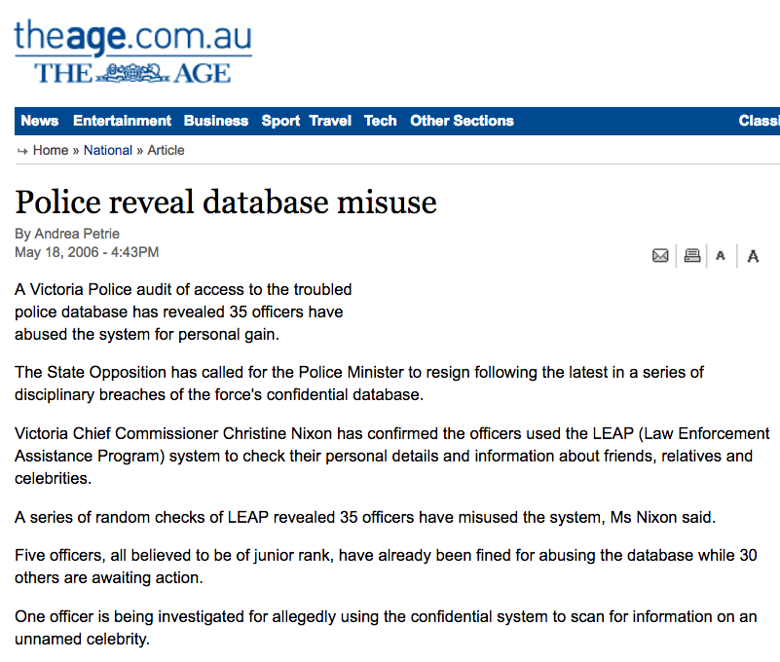
9.10 Sensitive data access is logged
Verify accessing sensitive data is logged, if the data is collected under relevant data protection directives or where logging of accesses is required.
Provides an audit trail of searching for famous people for those systems where this is not permitted

Slide 160
9.11 Clear memory of sensitive secrets
Verify that sensitive data is rapidly sanitized from memory as soon as it is no longer needed and handled in accordance to functions and techniques supported by the framework/library/operating system.
With Java, extremely difficult if not impossible
With .NET, use SecureString

Slide 161
Communications security

Slide 162
Mission Essential Task List
Duration | 60 minutes
Learning Objectives
Major Tasks
Conditions
Performance Standard
Tools Required
Notes:
The idea behind the METL is that it lays out exactly what you will be doing, how long for, the tasks you should expect to do and under what conditions and to what standard. Finally it helps you understand the tools required to achieve said tasks.

Slide 163
10.1 Use trusted certificates
Verify that a path can be built from a trusted CA to each Transport Layer Security (TLS) server certificate, and that each server certificate is valid.
Either get a basic certificate from a public CA OR
Get a properly signed certificate from your internal CA

Slide 164
10.3 Never fall back to unencrypted links
Verify that TLS is used for all connections (including both external and backend connections) that are authenticated or that involve sensitive data or functions, and does not fall back to insecure or unencrypted protocols. Ensure the strongest alternative is the preferred algorithm.
Easiest method is to disable port 80, but this has pretty awful UX
Ensure port 80 redirects immediately to TLS

Slide 165
10.4 TLS connections
Verify that backend TLS connection failures are logged.

Slide 166
10.4 Log all failures
Verify that backend TLS connection failures are logged.
This is very hard to achieve, may not actually be possible.

Slide 167
10.5 Client side certificates
Verify that certificate paths are built and verified for all client certificates using configured trust anchors and revocation information.
Client side (mutual authentication) certificates are a form of 2FA
Ensure these certificates are trustable by all likely end points

Slide 168
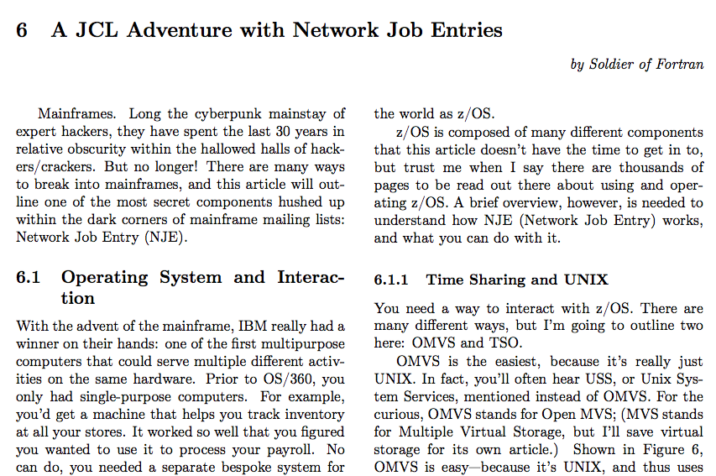
10.6 Authenticate external connections
Verify that all connections to external systems that involve sensitive information or functions are authenticated.
Notes:
PoC || GTFO

Slide 169
10.8 Use only one TLS configuration
Verify that there is a single standard TLS implementation that is used by the application that is configured to operate in an approved mode of operation.
Don’t use multiple versions of OpenSSL
Use the best configuration available

Slide 170
10.10 Certificate pinning
Verify that TLS certificate public key pinning is implemented with production and backup public keys.
https://www.owasp.org/index.php/Pinning_Cheat_Sheet

Slide 171
10.11 Strict transport security
Verify that HTTP Strict Transport Security headers are included on all requests and for all subdomains, such as Strict-Transport-Security: max-age=15724800; includeSubdomains
Once a browser has seen a site with HSTS, it never makes another connection on port 80, even if the user types that in.

Slide 172
10.12 Preload HSTS data into browsers
Verify that production website URL has been submitted to preloaded list of Strict Transport Security domains maintained by web browser vendors.
https://developer.mozilla.org/en/docs/Web/Security/Public_Key_Pinning

Slide 173
10.13 Enable perfect forward secrecy
Ensure forward secrecy ciphers are in use to mitigate passive attackers recording traffic.
Prevents plain text recovery of encrypted contents after the first key exchange.
https://wiki.mozilla.org/Security/Server_Side_TLS

Slide 174
V10.14 OSCP Stapling
Verify that proper certification revocation, such as Online Certificate Status Protocol (OSCP) Stapling, is enabled and configured.
https://wiki.mozilla.org/Security/Server_Side_TLS

Slide 175
V10.15 Strong configuration
Verify that only strong algorithms, ciphers, and protocols are used, through all the certificate hierarchy, including root and intermediary certificates of your selected certifying authority.
Use SSL Labs for an external site
Otherwise, SSLyze and similar tools are excellent methods to test TLS configuration from an integration point of view.

Slide 176
V10.16
Verify that the TLS settings are in line with current leading practice, particularly as common configurations, ciphers, and algorithms become insecure.
https://ssllabs.com

Slide 177
Cryptography demo
SSL Labs
sslyze

Slide 178
HTTP security

Slide 179
Mission Essential Task List
Duration | 60 minutes
Learning Objectives
Major Tasks
Conditions
Performance Standard
Tools Required
Notes:
The idea behind the METL is that it lays out exactly what you will be doing, how long for, the tasks you should expect to do and under what conditions and to what standard. Finally it helps you understand the tools required to achieve said tasks.

Slide 180
11.1 Only enable HTTP methods you use
Verify that the application accepts only a defined set of required HTTP request methods, such as GET and POST are accepted, and unused methods (e.g. TRACE, PUT, and DELETE) are explicitly blocked.
OPTIONS -> HEAD == pre-flight
Do not disable PUT and DELETE if you have a RESTful API
Test for common HTTP method issues using nikto and davtest

Slide 181
11.2 Send a safe content type
Verify that every HTTP response contains a content type header specifying a safe character set (e.g., UTF-8, ISO 8859-1).

Slide 182
11.3 Ensure SSO headers are trustworthy
Verify that HTTP headers added by a trusted proxy or SSO devices, such as a bearer token, are authenticated by the application.
Too many apps trust SSO headers
Ensure you ask the SSO infrastructure if a SSO header is valid the first time you see it
Re-validate if it changes

Slide 183
11.4 Enable X-FRAME-OPTIONS or a CSP to prevent framing
Verify that the Content Security Policy V2 (CSP) is in use for sites where content should not be viewed in a 3rd-party X-Frame.
https://www.owasp.org/index.php?title=Content_Security_Policy_Cheat_Sheet&setlang=en
X-FRAME-OPTIONS is also valid choice, but CSP has other benefits

Slide 184
11.5 Turn off advertising headers
Verify that the HTTP headers or any part of the HTTP response do not expose detailed version information of system components.
Usually can be removed via configuration, or worst case – via WAF rewriting rules
OWASP mod_security

Slide 185
11.6 Send a non-executable JSON format
Verify that all API responses contain X-Content-Type-Options: nosniff and Content-Disposition: attachment; filename="api.json" (or other appropriate filename for the content type).
This is avoid XSS within a JSON response firing if rendered directly by the browser

Slide 186
11.7 Create a content security policy
Verify that the Content Security Policy V2 (CSP) is in use in a way that either disables inline JavaScript or provides an integrity check on inline JavaScript with CSP noncing or hashing.
https://www.owasp.org/index.php?title=Content_Security_Policy_Cheat_Sheet&setlang=en

Slide 187
11.8 Enable IE Reflected XSS protections
Verify that the X-XSS-Protection: 1; mode=block header is in place.
Not terribly useful for mainstream browsers, but still helpful if your clients mostly use IE

Slide 188
Business logic flaws

Slide 189
Mission Essential Task List
Duration | 60 minutes
Learning Objectives | To understand all you can about the application to be assessed.
Major Tasks | Understand basic fraud, and how to think outside of the box to enable secure business
Conditions | None
Performance Standard | Understanding how to protect against these issues, and to test for them
Tools Required | OWASP Zap, Security Shepherd or WebGoat
Notes:
The idea behind the METL is that it lays out exactly what you will be doing, how long for, the tasks you should expect to do and under what conditions and to what standard. Finally it helps you understand the tools required to achieve said tasks.

Slide 190
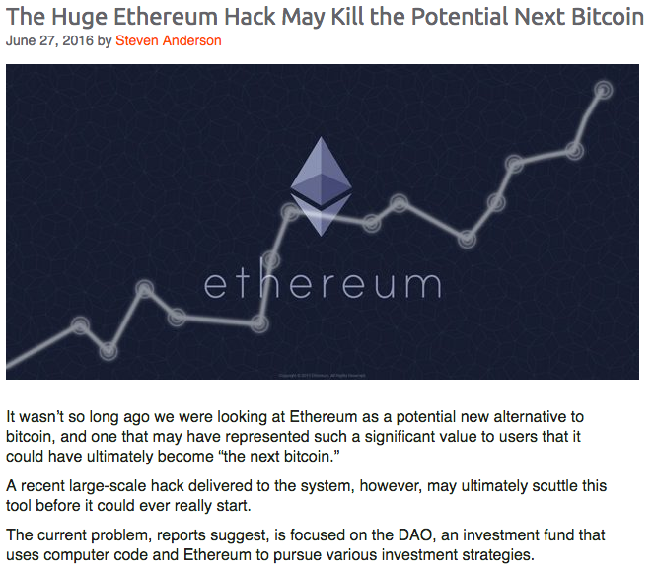
Business logic flaws
All applications do *something*
Some of these flows are high value business logic flows
Bugs within these flows might allow an attacker to cause financial loss, reputation loss, privacy loss or incur a steep regulatory response

Slide 191
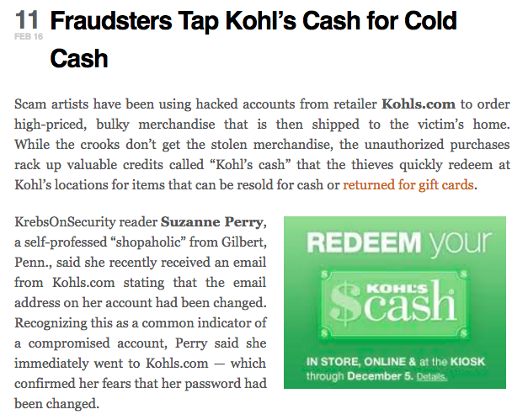
15.1 Secure high value business flows
Verify the application will only process business logic flows in sequential step order, with all steps being processed in realistic human time, and not process out of order, skipped steps, process steps from another user, or too quickly submitted transactions.

Slide 192
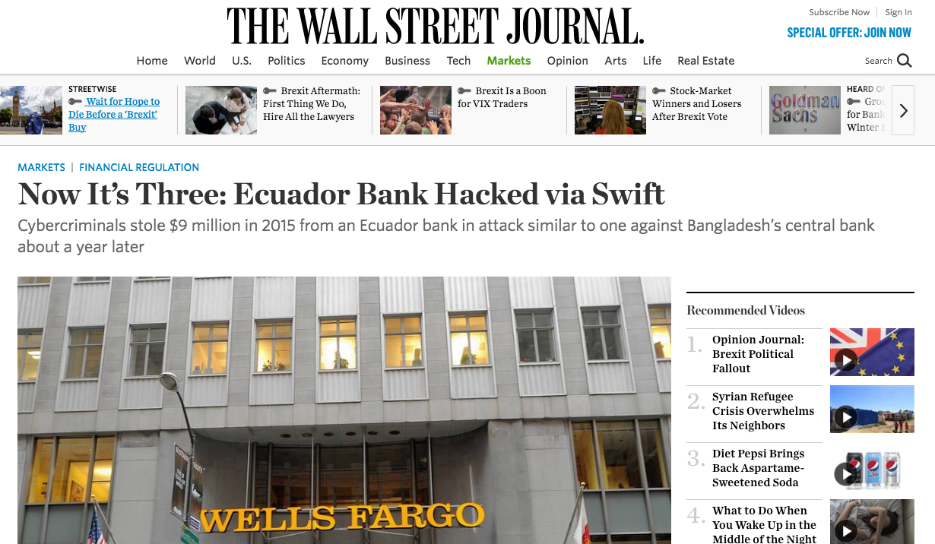
15.2 Enable secure business limits
Verify the application has business limits and correctly enforces on a per user basis, with configurable alerting and automated reactions to automated or unusual attack.

Slide 193
Files and Resources

Slide 194
Mission Essential Task List
Duration | 60 minutes
Learning Objectives | Learn how to protect against file upload attacks, URL redirection, local and remote include and XXE
Major Tasks | Consider the potential places where users can upload hostile data, try to change file metadata, and control the flow of execution through various file formats and meta data
Conditions | None
Performance Standard | Understanding how to protect against these issues, and to test for them
Tools Required | OWASP Zap, Security Shepherd or WebGoat
Notes:
The idea behind the METL is that it lays out exactly what you will be doing, how long for, the tasks you should expect to do and under what conditions and to what standard. Finally it helps you understand the tools required to achieve said tasks.

Slide 195
16.1 Protect URL redirections
Verify that URL redirects and forwards only allow whitelisted destinations, or show a warning when redirecting to potentially untrusted content.
Security Shepherd: Lab

Slide 196
16.2 Protect against file and path injection attacks
Verify that untrusted file data submitted to the application is not used directly with file I/O commands, particularly to protect against path traversal, local file include, file mime type, and OS command injection vulnerabilities.
WebGoat – command injection demo

Slide 197
16.3 Protect against known malicious files
Verify that files obtained from untrusted sources are validated to be of expected type and scanned by antivirus scanners to prevent upload of known malicious content.
Always scan uploaded files using an end point protection tool
Consider using Virus Total API to validate the hash of the file is not malicious (slow)

Slide 198
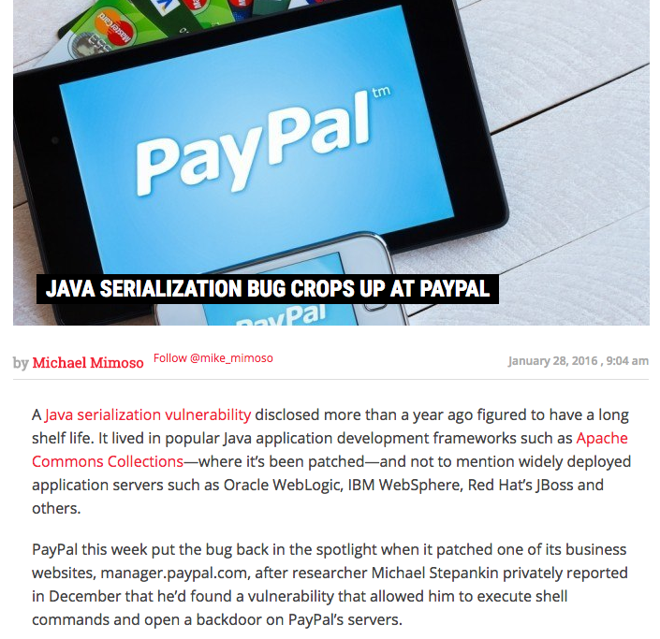
16.4 Protect against local and remote file inclusion
Verify that untrusted data is not used within inclusion, class loader, or reflection capabilities to prevent remote/local file inclusion vulnerabilities.

Slide 199
16.5 Cross-origin resource sharing security
Verify that untrusted data is not used within cross-domain resource sharing (CORS) to protect against arbitrary remote content.
https://www.owasp.org/index.php/Test_Cross_Origin_Resource_Sharing_(OTG-CLIENT-007)

Slide 200
16.6 Ensure file upload areas are secure
Verify that files obtained from untrusted sources are stored outside the webroot, with limited permissions, preferably with strong validation.
Always ignore filenames / paths supplied by the user
Store files outside the webroot
Scan them for nasties
Provide them back using octet streams

Slide 201
16.7 Only allow permitted external connections
Verify that the web or application server is configured by default to deny access to remote resources or systems outside the web or application server.
Use security groups or outbound firewall rules to allow only limited communication to the Internet
Even DNS channels can be abused, so be cautious of allowing untracked traffic from a host to the Internet

Slide 202
16.8 Protect against second order injection
Verify the application code does not execute uploaded data obtained from untrusted sources.
Primarily affects batch and message queue systems
Mainframes FTW
See Soldier of Fortran on Twitter

Slide 203
Do not use old client side technologies
Do not use Flash, Active-X, Silverlight, NACL, client-side Java or other client side technologies not supported natively via W3C browser standards.

Slide 204
Mobile security

Slide 205
Mission Essential Task List
Duration
Learning Objectives
Major Tasks
Conditions
Performance Standard
Tools Required
Notes:
The idea behind the METL is that it lays out exactly what you will be doing, how long for, the tasks you should expect to do and under what conditions and to what standard. Finally it helps you understand the tools required to achieve said tasks.

Slide 206
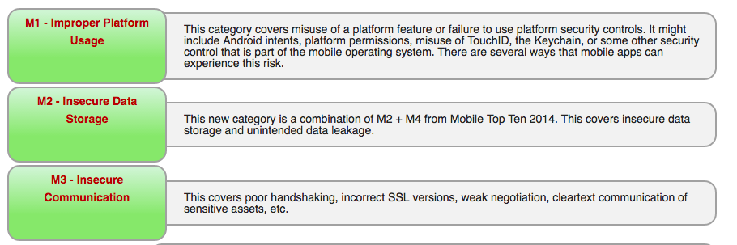

Slide 207
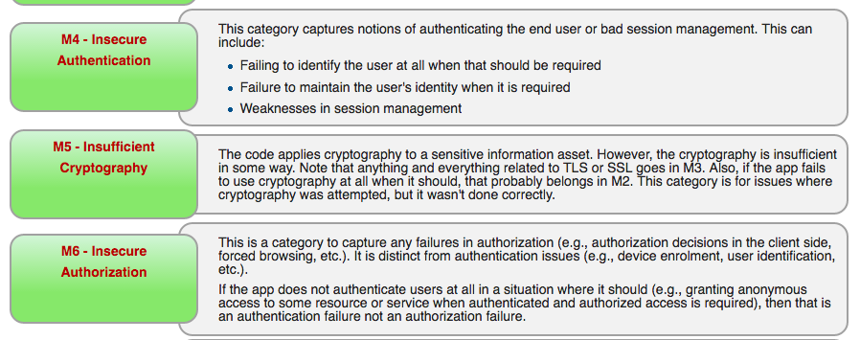

Slide 208
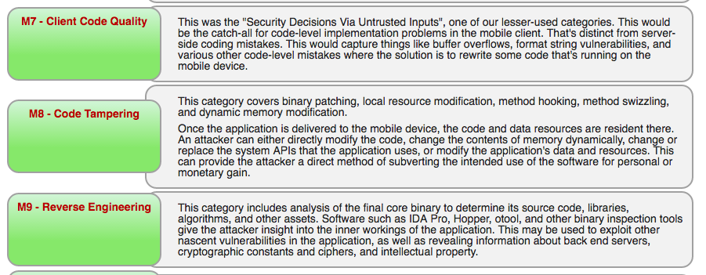

Slide 209
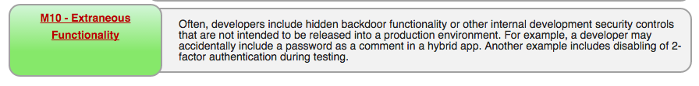

Slide 210
17.1 Do not rely on advertising IDs
Verify that ID values stored on the device and retrievable by other applications, such as the UDID or IMEI number are not used as authentication tokens.
https://www.owasp.org/index.php/Mobile_Top_10_2016-Top_10

Slide 211
17.2 Local storage might be unencrypted
Verify that the mobile app does not store sensitive data onto potentially unencrypted shared resources on the device (e.g. SD card or shared folders).

Slide 212
17.3 Local storage cannot be trusted
Verify that sensitive data is not stored unprotected on the device, even in system protected areas such as key chains.

Slide 213
17.4 Always compile with security flags
Verify that the application sensitive code is laid out unpredictably in memory (For example ASLR).

Slide 214
17.5 Block leakage of sensitive information
Verify that the mobile app prevents leaking of sensitive information (for example, screenshots are saved of the current application as the application is backgrounded or writing sensitive information in console) .
Don’t export intents and

Slide 215
17.6 Only ask for permissions you need
Verify that the application is requesting minimal permissions for required functionality and resources.
Android in particular – I am looking at you
iOS asks the user first time a permission is invoked

Slide 216
17.7 Enable ASLR
Verify that the application sensitive code is laid out unpredictably in memory (For example ASLR).
ASLR Enabled by default since iOS 4.3
Non-executable stack and heap is on by default. Do NOT pass –allow_stack_execute to your compiler!

Slide 217
17.8 Anti-debugging / jail break detection
Verify that there are anti-debugging techniques present that are sufficient enough to deter or delay likely attackers from injecting debuggers into the mobile app (For example GDB).
A delaying tactic

Slide 218
17.9 Secure your mobile app end points
Verify that the app does not export sensitive activities, intents, content providers etc., for other mobile apps on the same device to exploit.
Don’t allow attackers to bypass login or business logic verification by exporting sensitive end points

Slide 219
17.10 Scrub memory of sensitive information
Verify that mutable structures have been used for sensitive strings such as account numbers and are overwritten when not used. (Mitigate damage from memory analysis attacks).
Difficult on Android (JVM based), but where possible, scrub memory that contains sensitive information as quickly as possible

Slide 220
17.11 Validate remote procedure call data
Verify that the app’s exposed activities, intents, content providers etc. validate all inputs.
Other apps on the phone can call your RPC end points
Validate as if the user is completely hostile

Slide 221
Web Services Security

Slide 222
Mission Essential Task List
Duration | 30 minutes
Learning Objectives | Learn how to secure web services
Major Tasks
Conditions
Performance Standard
Tools Required
Notes:
The idea behind the METL is that it lays out exactly what you will be doing, how long for, the tasks you should expect to do and under what conditions and to what standard. Finally it helps you understand the tools required to achieve said tasks.

Slide 223
18.1 Unicode Encoding
Verify that the same encoding style is used between the client and the server
Use UTF-8 everywhere

Slide 224
18.2 Protect administrative API
Verify that access to administration and management functions within the Web Service Application is limited to web service administrators.
RESTful API should be designed with administrators in mind
Privileged non-admin API can be the same:
PUT /v1/API/method
Access control is your friend

Slide 225
18.3 Verify input data against high quality schema
Verify that XML or JSON schema is in place and verified before accepting input.
JSON schema validators exist, use them
http://json-schema.org/implementations.html

Slide 226
18.4 Constrain data sizes
Verify that all input is limited to an appropriate size limit.
Unbounded data can be input, but how do you proceed if you allow GB requests?

Slide 227
18.5 tl;dr – Always encrypt
Verify that SOAP based web services are compliant with Web Services-Interoperability (WS-I) Basic Profile at minimum.
WS-I == TLS always
This applies to SOAP requests

Slide 228
18.6 Use oAuth or JWT, not API keys
Verify the use of session-based authentication and authorization. Please refer to sections 2, 3 and 4 for further guidance. Avoid the use of static "API keys" and similar.
Build software that doesn’t contain secrets, just end points that can be authenticated
https://jwt.io/

Slide 229
18.7 Protect against CSRF attacks
Verify that the REST service is protected from Cross-Site Request Forgery.
Verify random nonce or double cookie submit pattern
Verify ORIGIN header
Verify referrer
https://www.owasp.org/index.php/Cross-Site_Request_Forgery_(CSRF)_Prevention_Cheat_Sheet

Slide 230
18.8 Positive validation of content types
Verify the REST service explicitly check the incoming Content-Type to be the expected type, such as application/xml or application/json.
Primarily to avoid naïve curl / wget / bot based attacks
Validate the header and only move forward to validating authentication and authorization claims

Slide 231
18.9 Digitally sign your payloads
Verify that the message payload is signed to ensure reliable transport between client and service.
JSON Web Signature
https://tools.ietf.org/html/rfc7515

Slide 232
18.10 Do not allow unencrypted or unauthenticated access
Verify that alternative and less secure access paths do not exist.
Enforce the use of TLS; don’t even publish port 80
Only unauthenticated calls should be for login and registration
All others should enforce authentication claims

Slide 233
Configuration

Slide 234
Mission Essential Task List
Duration
Learning Objectives
Major Tasks
Conditions
Performance Standard
Tools Required
Notes:
The idea behind the METL is that it lays out exactly what you will be doing, how long for, the tasks you should expect to do and under what conditions and to what standard. Finally it helps you understand the tools required to achieve said tasks.

Slide 235
19.1 Up to date components
All components should be up to date with proper security configuration(s) and version(s). This should include removal of unneeded configurations and folders such as sample applications, platform documentation, and default or example users.
OWASP Dependency Checker as a blocker CI check
Retire.js as a blocker CI check – for node and single page apps
Secure build - always build with the latest components and ensure that a full test suite can be run

Slide 236
V19.2 Encrypt between components
Communications between components, such as between the application server and the database server, should be encrypted, particularly when the components are in different containers or on different systems.
Client
App Server
Database

Slide 237
V19.3 Principal of least privilege
Communications between components, such as between the application server and the database server should be authenticated using an account with the least necessary privileges.
Don’t connect using dbo, use the least possible privileges
Consider partitioning into read only connections, read/write connections, and admin connections
That way, users who might achieve SQL injection can only select data that their db user can see

Slide 238
V19.4 Sandbox or isolate components
Verify application deployments are adequately sandboxed, containerized or isolated to delay and deter attackers from attacking other applications.
Containerization (Docker, Vagrant, etc) is the easiest way to do this
If running on traditional servers, consider the use of SE Linux or strict Windows permissions

Slide 239
V19.5 Automated secure builds
Verify that the application build and deployment processes are performed in a secure fashion.
Always use scripts to build securely
Use a CI server
Run OWASP Zap via API runner with Cucumber reporting
Run automated unit and integration tests
Run dependency checks as a blocker activity

Slide 240
19.6 Sign or hash your configurations
Verify that authorised administrators have the capability to verify the integrity of all security-relevant configurations to ensure that they have not been tampered with.
Digitally sign configuration files and refuse to start if the configuration file does not verify.
Can use GPG for the highest trust, but realise that if you include the key within your app (assuming it can make changes), folks will work out how to re-sign altered configuration

Slide 241
19.7 Digitally sign your work
Verify that all application components are signed.
Digitally sign (Android, iOS, macOS, Windows) or hash your deliverables
Can use GPG for the highest trust, but few users know how to use it

Slide 242
19.8 Use known repos for libraries
Verify that third party components come from trusted repositories.
Always consider the provenance of third party libraries
Always choose a common alternative over a less well known counterpart.
Reduce “like” libraries to 1

Slide 243
19.9 Enable all security relevant flags
Ensure that build processes for system level languages have all security flags enabled, such as ASLR, DEP, and security checks.
As part of the build process, review your compiler’s security flags, and enable all of them
Some warnings should be treated as blockers. The compiler is telling you something is wrong, so fix it.

Slide 244
Demo:
cvedetails.com
Finding out if we’re using the latest components

Slide 245
Battle Royale

Slide 246
Objective – Hack the CTF
The student with the top score at the end of the hour will win!
Do not look at the source code! Disqualification

Slide 247
References

Slide 248

OWASP
https://owasp.org

Slide 249
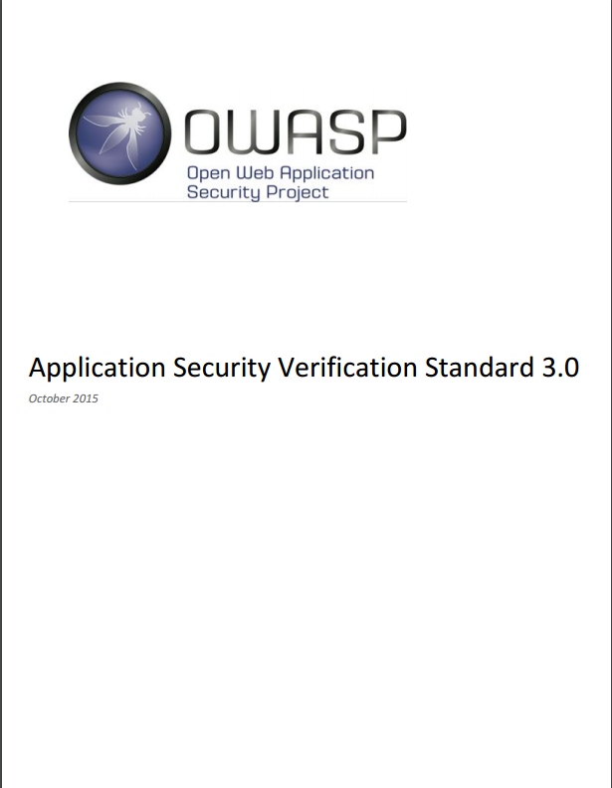
OWASP Application Security Verification Standard
Get it here:
https://www.owasp.org/index.php/Category:OWASP_Application_Security_Verification_Standard_Project
Fork it here:
https://github.com/OWASP/ASVS

Slide 250
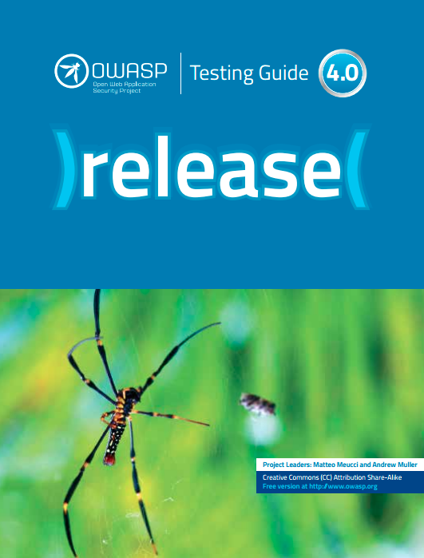
OWASP Testing Guide v4
Get it here:
https://www.owasp.org/index.php/OWASP_Testing_Project

Slide 251
OWASP Cheat Sheets
Get it here:
https://www.owasp.org/index.php/OWASP_Cheat_Sheet_Series#tab=Main

Slide 252
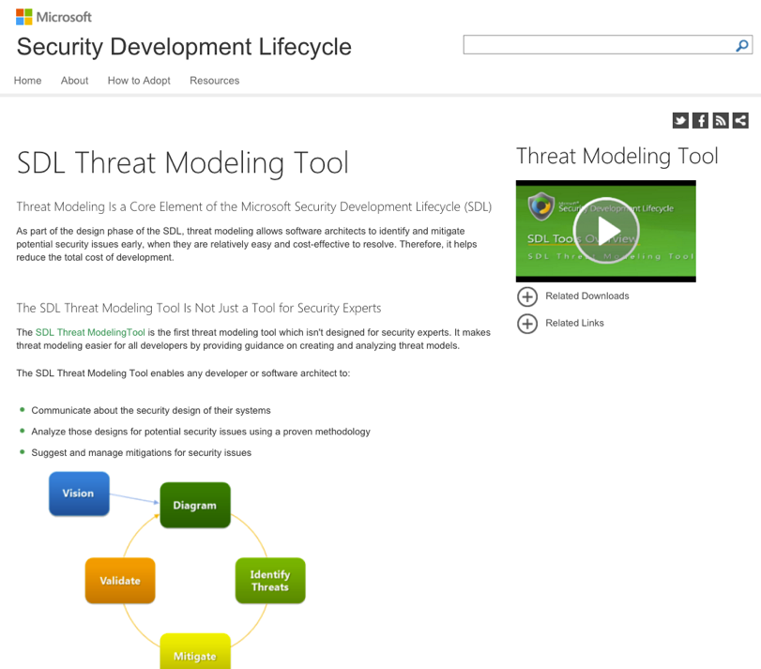
Microsoft SDL
SDL for Agile
https://www.microsoft.com/en-us/SDL/Discover/sdlagile.aspx
SDL for waterfall

Slide 253
Microsoft Tools
Threat Modelling Tool 2016
http://aka.ms/tmt2016
Attack Surface Analyzer
http://www.microsoft.com/en-us/download/details.aspx?id=24487

Slide 254
Wrapping up

Slide 255
Thank you!
Jim Manico, jim.manico@owasp.org
@, +
P: +XX-XXX-XXXX
Andrew van der Stock, vanderaj@owasp.org
@vanderaj, +Andrew van der Stock
P: +61 422 644 792
With thanks to Daniel Cuthbert

Slide 256

Copyright notice and license
Copyright © 2008 – 2016 The OWASP Foundation.
This document is released under the Creative Commons Attribution ShareAlike 3.0 license. For any reuse or distribution, you must make clear to others the license terms of this work.

Slide 257
OWASP Brand Usage Guidelines
The Open Web Application Security Project (OWASP) is a 501(c)(3) worldwide not-for-profit charitable organization focused on improving the security of software.
Our mission is to make software security visible, so that individuals and organizations worldwide can make informed decisions about true software security risks.
Everyone is free to participate in OWASP and all of our materials are available under a free and open software license. You'll find everything about OWASP linked from our wiki and current information on our OWASP Blog.
OWASP does not endorse or recommend commercial products or services, allowing our community to remain vendor neutral with the collective wisdom of the best minds in software security worldwide. We ask that the community look out for inappropriate uses of the OWASP brand including use of our name, logos, project names and other trademark issues.
https://owasp.org

